Slide 1
XB Donor Intelligence
Summer 2025 Project Update
Serena Yin
OUSG - PAS
Wednesday, July 23rd, 2025

Slide 2

Problem Statement Limited Donor Intelligence Capabilities Hinder Strategic Engagement with Member States
DRAFT - FOR INTERNAL USE ONLY
How can we enhance donor intelligence capabilities to increase effectiveness of discussions with Member States, ultimately boosting XB funding?
What intelligence would be valuable to know when discussing with Member States?
What tools are needed to effectively capture, visualize, and share donor intelligence?

Slide 3





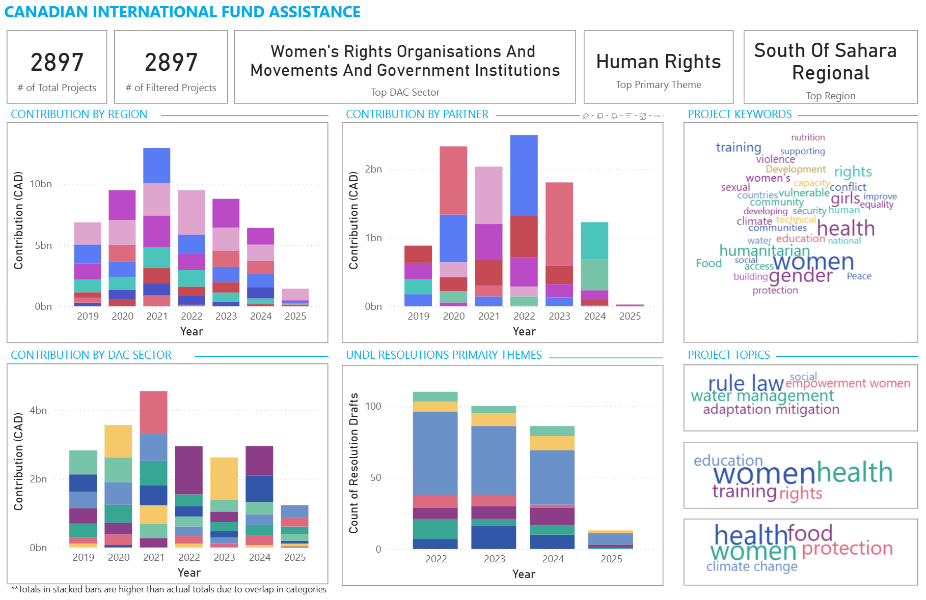
Methodology Three Member States were selected as the initial focus group to validate results and findings derived from UN resolutions, news articles, speeches, and published foreign aid data
DRAFT - FOR INTERNAL USE ONLY
Member States Focus Group¹
Canada
United Arab Emirates
Qatar
Donor Intelligence Collection Process
1
UN Resolutions and Drafts²
2
Permanent Mission
News Articles
3
GA and Security Council Statements²
Utilize AI to categorize and identify key themes and social issues mentioned in qualitative data
4
MoFA Foreign Aid Data³
Focus group chosen based on existing internal expertise to validate results
UN Resolutions sponsored and co-sponsored by Member States and Statements/Speeches made by Member States sourced from the UN Digital Library
Only select Member States’ Ministry of Foreign Affairs publish foreign aid data

Slide 4
Results Report for Canada accurately identifies Women’s Rights/ Gender Equality as a donor priority¹
DRAFT - FOR INTERNAL USE ONLY
Key Findings
Top DAC Sector is “Women’s Rights Organisations and Movements and Government Institutions”
DAC Sectors are given by the original data source
“Women” and “Gender” are the top keywords/topics as seen in the word cloud visualizations
Word clouds visualize keyword frequency and the top 3 LDA topics from project descriptions
Determined based on pre-existing understanding and internal expertise on Canada’s funding priorities

Slide 5
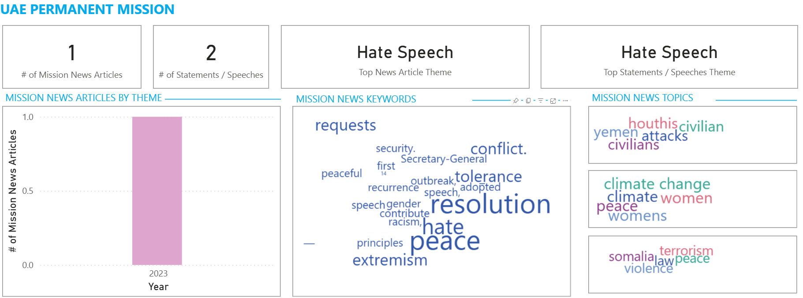
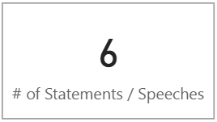
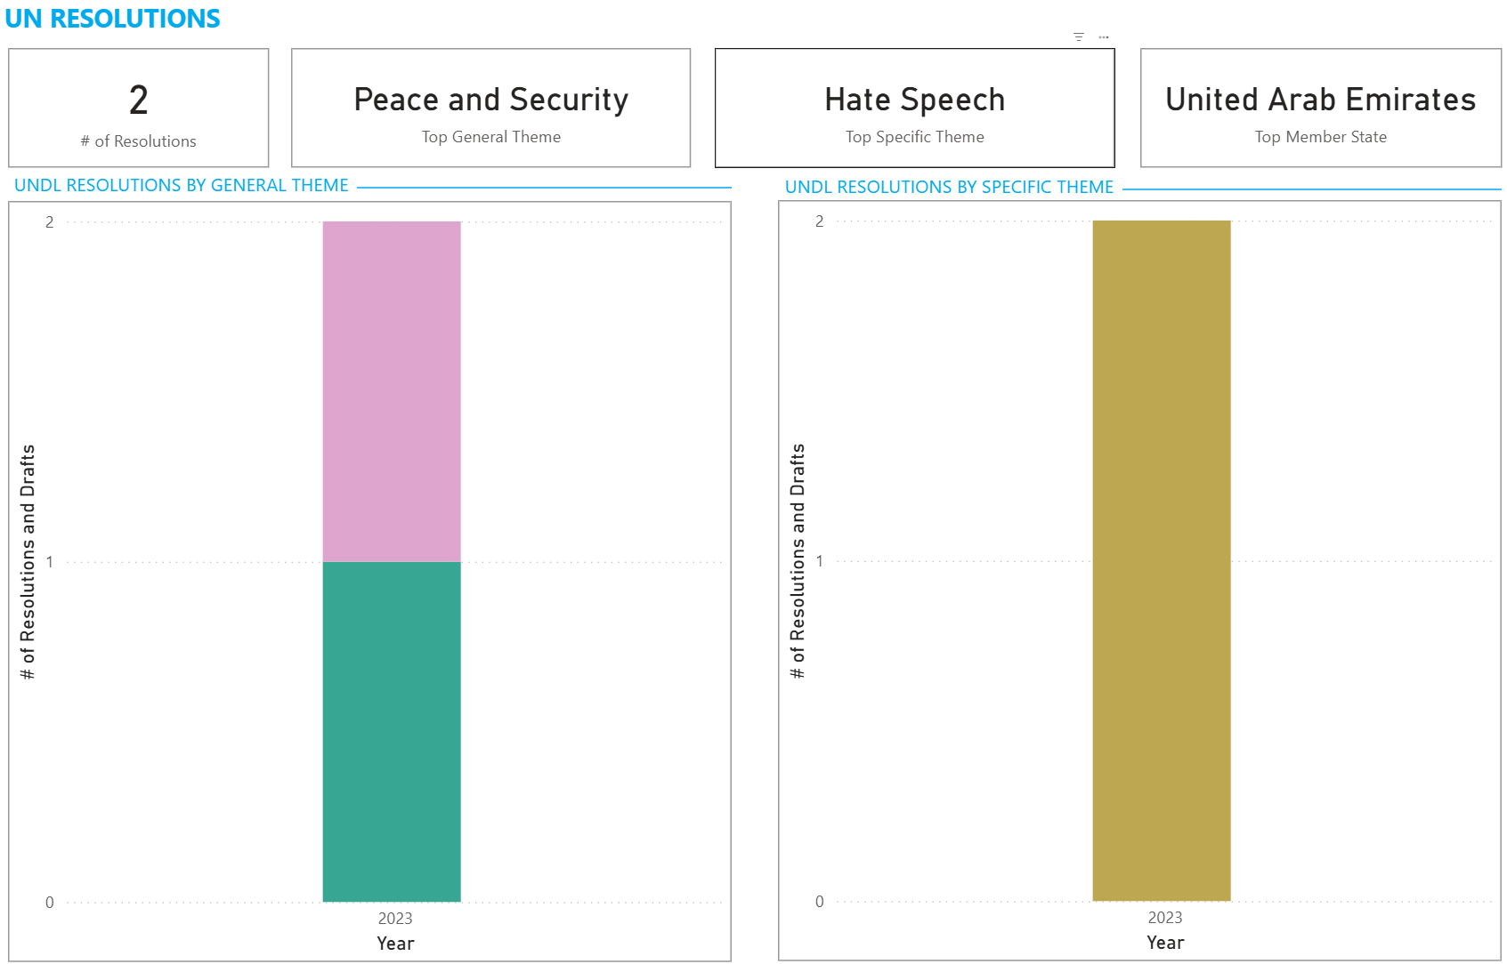
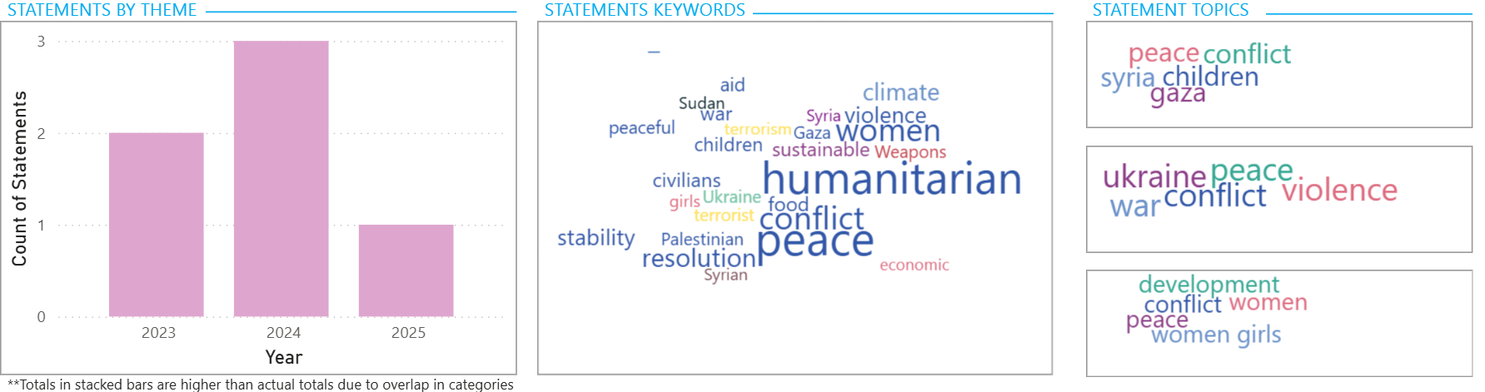
Results Despite prioritizing Hate Speech¹, the UAE has published limited news/statements on the topic, indicating potential bias in data sources
DRAFT - FOR INTERNAL USE ONLY
Key Findings
Only 1 of 44 news articles on UAE’s Permanent Mission website focuses on Hate Speech
Only 6 of 639 statements/ speeches focus on Hate Speech
UAE has only sponsored/co-sponsored 2 UN Resolutions focused on Hate Speech
XB Donor Intelligence Tool may be biased due to potential discrepancies between information being published by Member States and their donor priorities
Determined based on pre-existing understanding and internal expertise on UAE’s funding priorities

Slide 6



Important Limitations Limited and outdated external data undermine accurate understanding of donor priorities
DRAFT - FOR INTERNAL USE ONLY
Sparse Data
Data Bias
Data Extrapolation
For Member States where internal knowledge and engagement are limited, external data sources also tend to be limited
Public data published by Member States may be biased, potentially skewing analysis on donor priorities
Primarily relying on historical data may not be an accurate indicator of current donor priorities

Slide 7
Next Steps Next Steps focus on expanding data sources to capture more current trends, optimizing the dashboard for usability, and establishing clear documentation to support long-term use
DRAFT - FOR INTERNAL USE ONLY
Expand Data Sources + Member States
Dashboard Optimization
Documentation + Handover
Sources that capture more current information about each Member State
Social Media
LinkedIn
Twitter/X
Facebook/Instagram
Other Government Departments
Expand data scraping to other Member States
Enhance usability by prioritizing intuitive layout and clear information hierarchy
Streamline navigation to support faster access to relevant donor insights
Develop a user guide on how to navigate and interpret dashboard insights
Document methodology for future reference and maintenance

Slide 8
DASHBOARD DEMO

Slide 9
Thank you!

